Slide 1
Constructing Safety Assurance Cases for Medical Devices
Arnab Ray, PhD
Senior Research Scientist
Fraunhofer USA Center for Experimental Software Engineering
Rance Cleaveland, PhD Professor,
Department of Computer Science
University of Maryland

Slide 2
The Food And Drug Administration
Federal body charged with the responsibility of “protecting the public health by assuring the safety, efficacy and security of human and veterinary drugs, biological products, medical devices, our nation’s food supply, cosmetics, and products that emit radiation”

Slide 3
The Regulatory Process
510(k): device to be marketed is as safe and effective, that is, substantially equivalent (SE), to a legally marketed device that is not subject to premarket approval (PMA)
PMA: Approval based on a determination by FDA that the PMA contains sufficient valid scientific evidence that provides reasonable assurance that the device is safe and effective for its intended use or uses

Slide 4
Outline Of Talk
Problem with medical device “submissions” to the FDA
Safety assurance cases—a solution?
More problems with that
Some light inside the tunnel

Slide 5
Definition of Safety
Safety: Does not harm the patient (i.e. it cannot do something bad)
e.g. introduce an air bubble into bloodstream
Effectiveness: Does something “good” (clinically)
e.g. a device that claims to detect early signs of a particular type of cancer actually does what it claims

Slide 6
The General Problem
Manufacturers:
The PMA/510(k) process is expensive
Procedures and expectations from the FDA, they claim, are not clearly defined
Regulatory regime provides a high cost of entry for new players

Slide 7
The General Problem
Regulators
Submissions become more complex
Software !
Time given to regulators to take decisions has remained same
Submissions remain unstructured
Table of contents pointing to different sections of submission is provided
How the different sections contribute to safety argument not clear

Slide 8
External Infusion Pumps
An infusion pump infuses fluids, medication or nutrients into a patient's circulatory system
Problematic class of devices responsible for a number of adverse events every year
Includes insulin pumps, patient-controlled analgesic pumps

Slide 9
Guidance for Industry and FDA Staff
“FDA recommends that you submit your information through a framework known as an assurance case or assurance case report”

Slide 10
Manufacturers & Assurance Cases
“More regulatory overhead”
“Do I have to redo everything I have in terms of pictures?”
“Where should I start?”
“What would be acceptable evidence for the FDA?”
“How deep should we argue?”

Slide 11
Our Thesis
In any “approval worthy” device submission, the safety assurance case already exists, albeit in an implicit and undocumented form
Safety assurance case: Formally and explicitly codifies the logical trail of reasoning for a device’s safety

Slide 12
The Paper
Outlines an approach for safety assurance case argumentation
Goal: Serves as the logical glue for different parts of the submission

Slide 13
Example Used
The Generic Infusion Pump (GIP) Project
Goal: Create an exemplar set of hazards, requirements, models for GIPs
Example: GPCA (Generic Patient Controlled Analgesic Pump)

Slide 14
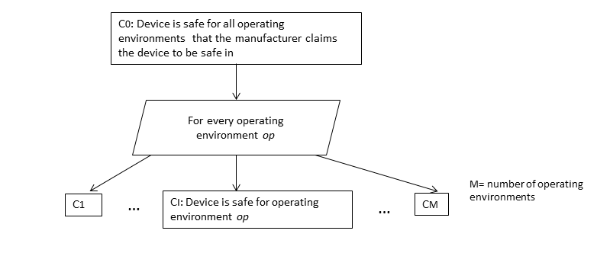
Note: Safety arguments vary by operating environment
A PCA pump safe for home may not be safe in a moving van !

Slide 15
What is Safe?
In order to claim a device does nothing “bad”
Comprehensively define “bad” (bad=anything that causes injury or death to human beings i.e. hazards)

Slide 16
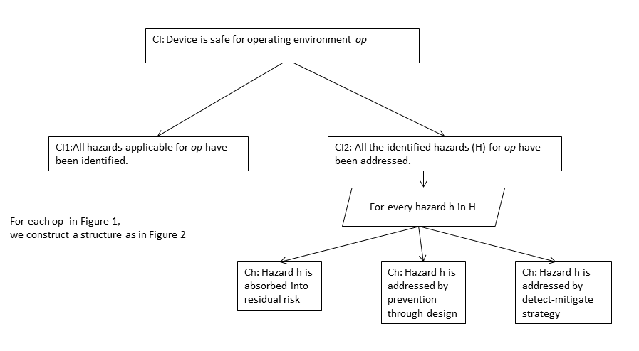
How do we establish this?

Slide 17
All hazards?
Theoretically impossible to claim all hazards have been identified
Strategies for arguments
Reference to standards
Past adverse events (“We handle all adverse events reported in the past to FDA”)
Predicate device (“We handle same set of hazards as this product on market”)

Slide 19
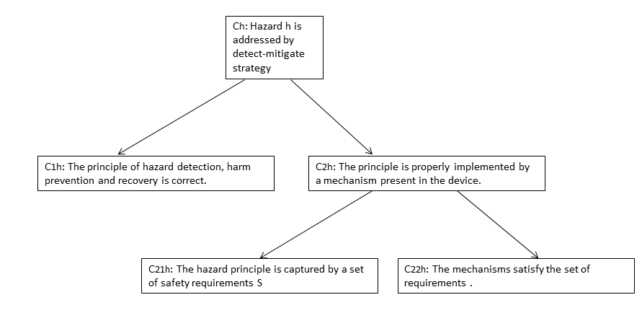

Slide 20
Example
The principle: “If bubble size is greater than X microns, then hazard air-in-line has occurred. The patient is not impacted if infusion is stopped before bubble reaches bloodstream and he is notified ”
Need to establish that this principle is correct

Slide 21
Mechanism?

Slide 22
Mechanism
Exclusively mechanical or electrical
Exclusively software (e.g. a range check for drug safe limits)
Combination of all of them (mechanical + electrical+ software)

Slide 23
Example
Sensor is mechanism that detects bubble size
Once safe limit is crossed, signal goes to software controller
Controller
sends message to alarm module
stops mechanical pump

Slide 24
Proof Obligations?
Entire mechanism is able to detect bubble size appropriately
(Time from bubble introduction to detection) + (Time from detection to stoppage of infusion)< Safe limit such that bubble does not reach bloodstream

Slide 25
Safety Requirements
A number of mechanism-specific constraints on implementations
R1: An air-bubble must be detected by sensor within “t” time units of its introduction.
R2: The controller software can transition from an infusion mode to an alarming mode within “s” time units of hazard detection by sensor.
R3: No infusion should be possible in the alarming mode.
R4: An alarm should be sufficiently loud to be heard.
R5: The time between the detection of an air-bubble and its entry into the patient’s bloodstream is more than s+t time units.

Slide 26
Safety Requirements
Set of safety requirements
is relevant (no safety requirement not linked to a hazard)
is exhaustive (all aspects of the principle of hazard detection, harm prevention and recovery have been translated to requirements)
is trustworthy (the safety requirements are internally consistent i.e. do not contradict each other)

Slide 28
Mechanisms Satisfy Requirements
Depends on the mechanism as to how its behavior is captured
Behavior of fully mechanical & electrical systems can be captured by specifications (motor speed, voltage rating etc)
Software systems are more problematic

Slide 29
More Sub-claims
“The software system satisfies the set of safety requirements” may broken down into sub-claims with a development standard (e.g. IEC 62304) as reference
One sub-claim for every step of the process (product specific)
Overall compliance with standard

Slide 30
Conclusions And Future Directions
No need to “re-do” what you have already done
Fill in the logical gaps
While a perfect assurance case may not be possible, something is better than nothing
Security Assurance Cases?

